Slide 1
Normalization: What and Why

Slide 2
Normalization: What and Why
When using a relational database management system, the database is a collection of tables.
A critical step in the database design process is deciding:
How many tables do we need to store the data for an application?
What data belongs in which table?

Slide 3
How Did We Decide Before?
These questions have plagued database designers for many years.
Initially we used intuition as our guide. We tended to group similar data items together in a table because it seemed to make sense to do so.
Example: all the data items describing an employee would be put in the employee table.

Slide 4
The Problem with Intuition
Some designers seemed to have good intuition.
They produced database designs that:
Worked well
Supported successful applications
Satisfied users
Other designers did not have good intuition.
They produced:
Poor database designs
Applications that did not work well
Unsatisfied users

Slide 5
The Problem with Intuition
The problem:
There was no systematic method to help designers decide:
How many tables there should be
What data items should be in each table

Slide 6
A Systematic Approach
Edgar F. Codd developed a set of rules called the:
Rules of Normalization
These rules can be applied when designing a relational database.
They guide us in deciding:
The number of tables there should be in a database
The assignment of data items (attributes) to the various tables

Slide 7
Normalization
The rules of normalization have changed somewhat since Codd's initial version.
However:
The normalization process remains the industry standard for designing a relational database.

Slide 8
Evaluating a Database Design
A database design can be evaluated based on two important criteria:
1. Does the design minimize redundant data?
2. Does the design minimize the occurrence of anomalies within the data?
Today we will look at how normalization helps us meet these criteria.

Slide 9
What Is an Anomaly?
An anomaly is an inconsistency in the data stored in a database.
There are three major types of anomalies:
Update
Insert
Delete
We will examine each one.

Slide 10
Minimizing Redundant Data
One criterion for a good database design is that the design minimizes redundant data.
Consider the following example.
Suppose we use intuition and decide to create one table to store both employee and department information.

Slide 11
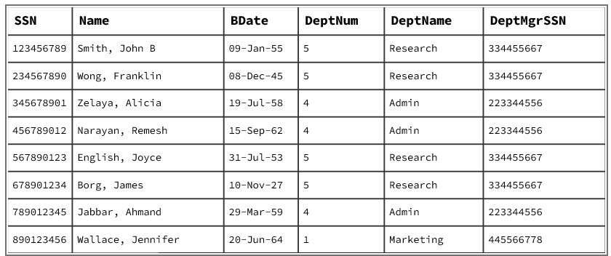
Minimizing Redundant Data
Employee Department
Notes:
Insert: What if I add a new employee, but I enter the wrong DeptMgrSSN for their Department?
Update: What if I update an employee's department but not their DeptMgrSSN or DeptName?
Delete: If I delete Jennifer, how do we know who manages the Marketing department?

Slide 12
Minimizing Redundant Data
What Is Repeated?
Under this design:
Department Name
  Research is repeated several times.
  Admin is repeated several times.
Department Manager
  The manager's SIN is also repeated several times. For example: 334455667 appears for every Research employee.

Slide 13
The Problem: Redundancy
We are storing the same department information repeatedly.
But the department itself has not changed.
Research is still one department.
Its manager is still one person.
Yet that information appears in multiple employee records. This is redundant data.

Slide 14
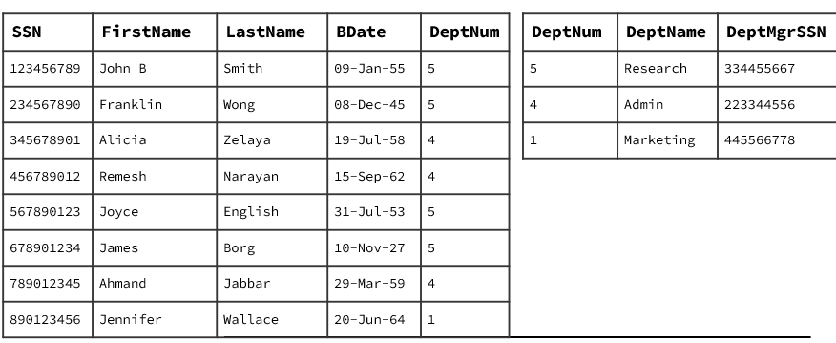
A Different Design
Applying the rules of normalization leads to the creation of:
Two tables
EMPLOYEE for employee information and
DEPARTMENT for department information.
Notes:
Insert: Now, adding a new employee means all I need to enter is the Dept #. Anomaly is avoided.
Update: If I update an employee's department number, no need to update any other department fields. Anomaly is avoided.
Delete: If I delete Jennifer, there is still Marketing info in the Department table… anomaly is avoided!

Slide 15
Redundancy Is Reduced
Applying normalization:
Data redundancy is reduced — not eliminated — in the normalized design.
Some repeated information may still be necessary.
For example:
DeptNo appears in both tables because it is used to relate employees to departments.

Slide 16
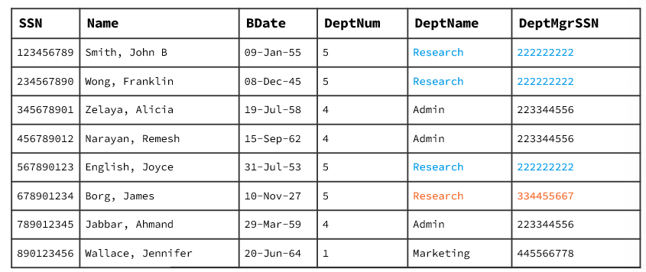
Update Anomaly: The Problem
Under the intuitive design:
Research appears in four rows.
Therefore, we must update the manager information in four rows.
What happens if:
Three rows are updated correctly
One row is forgotten?
We now have inconsistent information.

Slide 17
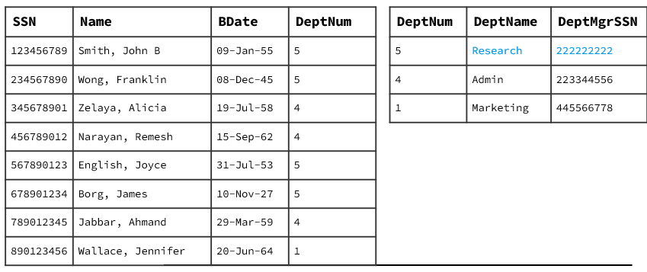
Update Anomaly: The Normalized Design
With the normalized design, we only need to update:
ONE ROW in the Department table.
Because the department is described by one row, all Research employees are associated with the same department record.

Slide 18
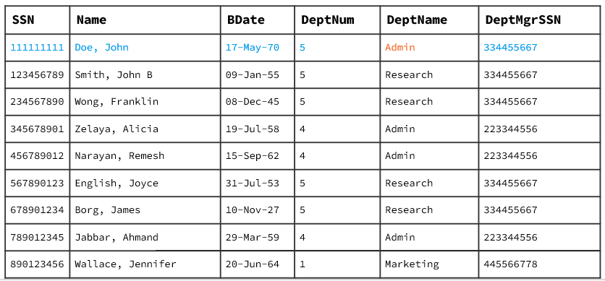
Minimizing Insert Anomalies
An insert anomaly occurs when we add new data to the database and cause an inconsistency in the data.
Scenario
We hire a new employee:
John Doe
What information do we need to add John to the database?

Slide 19
Insert Anomaly: The Problem
Under the intuitive design, we must know all the information about John's department in order to add John.
Suppose John works in Research.
We must enter:
Department number
Department name
Department manager
John's employee information.
What if the department information is entered incorrectly?
We have created an insert anomaly.

Slide 20
Insert Anomaly
Suppose we enter:
SIN | Name | Birthdate | Dept No | Dept Name | DMgrSIN
111111111 | Doe, John | 17-May-70 | 5 | Admin | 334455667
But Department 5 is actually: Research
The employee was inserted... but incorrect department information was also inserted.

Slide 21
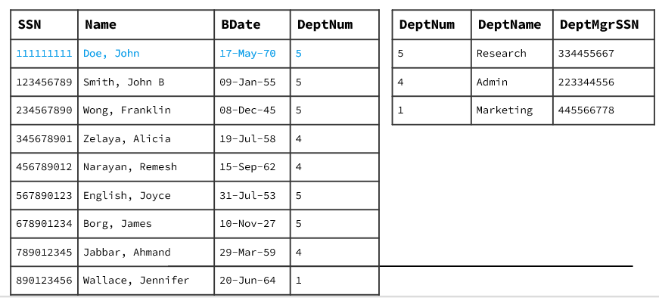
Insert Anomaly: The Normalized Design
With the normalized design, we do not need to enter all the department information when adding a new employee.
We only need: The department information is already stored in the Department table.
Result: This minimizes the likelihood that inserting an employee will create an anomaly.

Slide 22
Adding a New Department
Suppose the company expands and creates a new department.
Under the intuitive design:
The new department information cannot be recorded until the first employee is hired.
Why? Because the employee's SIN is the primary key for the EmployeeDepartment table.

Slide 23
Minimizing Delete Anomalies
A delete anomaly occurs when we delete data from the database and cause an inconsistency in the data.
Scenario:
All employees in the Marketing department transfer to other departments. If we delete Jennifer Wallace (the last Marketing employee):
We lose the information about the Marketing department itself.
Deleting employee information should not cause a loss of department information.
Result: The Marketing department no longer exists in the database — even though the department still exists!
Unnormalized Design:
SSN | Name | Dept No | Dept Name | Dept Mgr SSN
890123456 | Wallace, Jennifer | 1 | Marketing | 445566778

Slide 24
Delete Anomaly: The Problem
Under the intuitive design:
When the last employee in Marketing is deleted...
We lose the information about Marketing itself.
But: Deleting employee information should not cause a loss of information about a department.
The department and employee are two different things

Slide 25
Delete Anomaly: The Normalized Design
SSN | Name | Dept No (FK)
111111111 | Doe, John | 4
123456789 | Smith, John B | 5
234567890 | Wong, Franklin | 5
345678901 | Zelaya, Alicia | 4
456789012 | Narayan, Remesh | 4
567890123 | English, Joyce | 5
678901234 | Borg, James | 5
789012345 | Jabbar, Ahmad | 4
With the normalized design:
We can delete employee information without losing department information.
Why? Because:
Employee information is stored in the Employee table.
Department information is stored in the Department table.
Dept No | Dept Name | Dept Mgr SSN
5 | Research | 222222222
4 | Administration | 223344556
1 | Marketing | 445566778
Marketing still exists.
Even if there are currently no employees assigned to it.

Slide 26
The Three Anomalies
UPDATE
Changing repeated information can create inconsistencies.
INSERT
Adding information may require unrelated information to be entered.
DELETE
Deleting one type of information may accidentally remove another type of information.

Slide 27
What Caused These Problems?
The problems came from putting different kinds of information together in one table.
Our original table contained information about:
Employees and Departments
The department information was repeated for every employee.

Slide 28
What Did Normalization Do?
Normalization led us from:
One table: EmployeeDepartment to:
Separate tables: Employee And Department
This:
Reduces redundant data
Reduces the likelihood of anomalies
Makes updates safer
Allows information to be inserted independently
Allows information to be deleted independently

Slide 29
The Big Picture
By applying the rules of normalization to design a relational database, we create a design that:
Minimizes the amount of redundant data
and
Minimizes the likelihood of creating inconsistencies
within the database during the life of the application.

Slide 30
Key Questions
When evaluating a database design, ask:
1. Does the design minimize redundant data?
2. Does the design minimize the occurrence of anomalies?
3. Can information be updated safely?
4. Can information be inserted independently?
5. Can information be deleted without losing unrelated information?

Slide 31
What We've Learned
Normalization
Provides a systematic method for deciding:
How many tables we need
What attributes belong in each table
A good design should:
Minimize redundant data
Minimize anomalies
Three anomalies:
Update
Insert
Delete

Slide 32
One Important Point
Normalization:
Reduces redundancy — it does not eliminate all redundancy.
And normalization:
Minimizes the likelihood of anomalies — it does not mean that a database can never contain an error.
The goal is a better relational design.

